Slide 1
SHELTER IN PLACE TRAINING

Slide 2
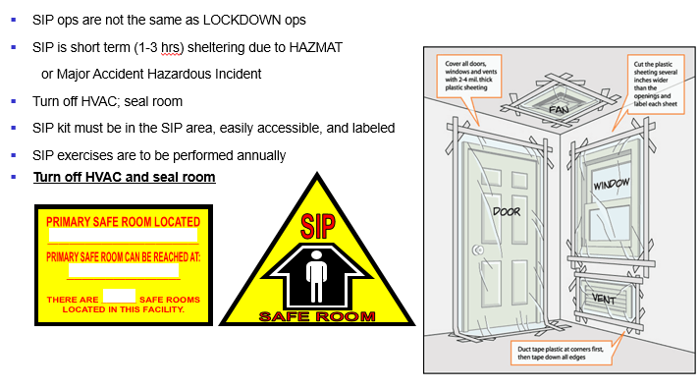
How to Seal Your Shelter In-Place SIP Room

Slide 3


Shelter In Place Coordinators
Contact the following personnel in your organization if you have questions on the location of the SIP room in your workplace:
Emergency Management Representatives
Facility Managers
Your facility may have more than one Shelter In-Place (SIP) room
Look for the following sign and placard:

Slide 4
EMERGENCY MANAGEMENT
Pam Clark 878-2376
or
James “Fergy” Ferguson 878-1796
Please call if you would like us to further explain Shelter In-Place procedures at your work place
633 CES/Emergency Management
Fort Eustis EOC, 1028 Schultz Place
Questions?

